Slide 1
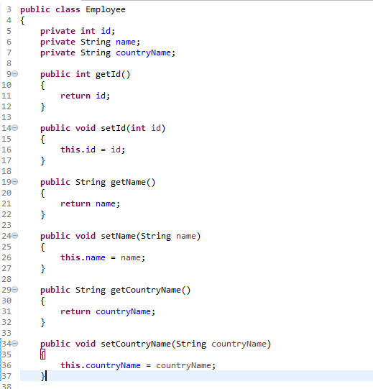
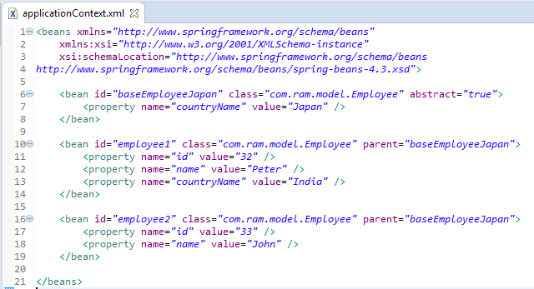
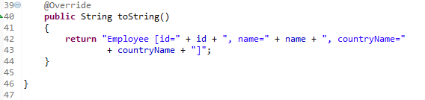
Spring bean configuration for inheritance - Override
In Spring, the inheritance is supported in bean configuration for a bean to share common values, properties or configurations.
A child bean or inherited bean can inherit its parent bean configurations, properties and some attributes. In additional, the child beans are allow to override the inherited value.
Above is a ‘baseEmployeeJapan’ bean contains a ‘Japan’ value for countryName property, and the ‘employee1’ and ‘employee2’ beans are inherited this value from its parent (‘baseEmployeeJapan’).We are still allow to override the inherited value by specify the new value in the child bean.

Slide 2
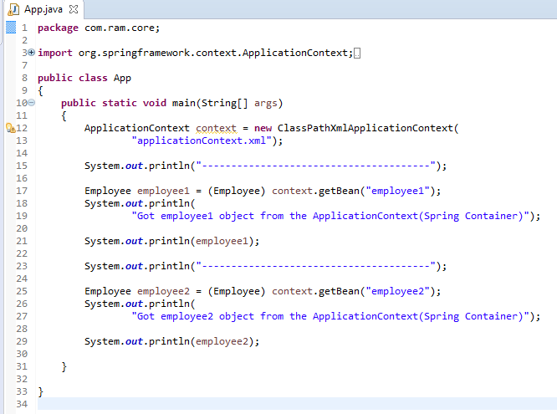
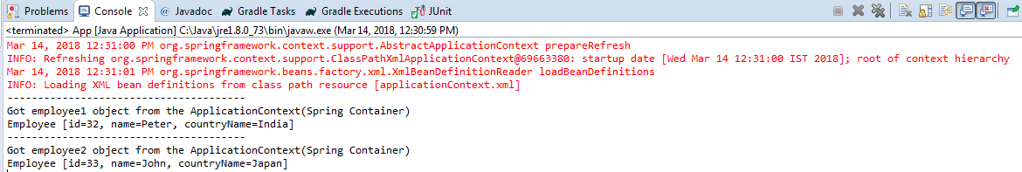
Spring bean configuration for inheritance - Override

